Slide 1



Data Mid-Bootcamp Classification Project
Credit Card Offer
Mario La Torre
Emanuel Panait
DAPT OCT 2022

Slide 2
Case Study: Classification
Scenario
We are working as a risk analyst with a bank. The bank provides credit card services and wants to understand the demographics and other characteristics of its customers that accept or not a credit card offer.​
The bank designs a focused marketing study, with 18,000 current bank customers that allows the bank to know who does and does not respond to the offer, and to use existing demographic data that is already available on each customer.
Objective​
Build a model that will provide insight into why some bank customers accept credit card offers.

Slide 3

Index
Objectives
Exploratory Data Analysis
Benchmark
Optimization
Models Comparison
Business Case

Slide 4

Objective
Build a model that will predict users who will accept a Credit Card offer
Get insights into groups of people who accepted an offer
The database comes from a focused marketing study organized by the bank with participation of 18,000 current customers.

Slide 5
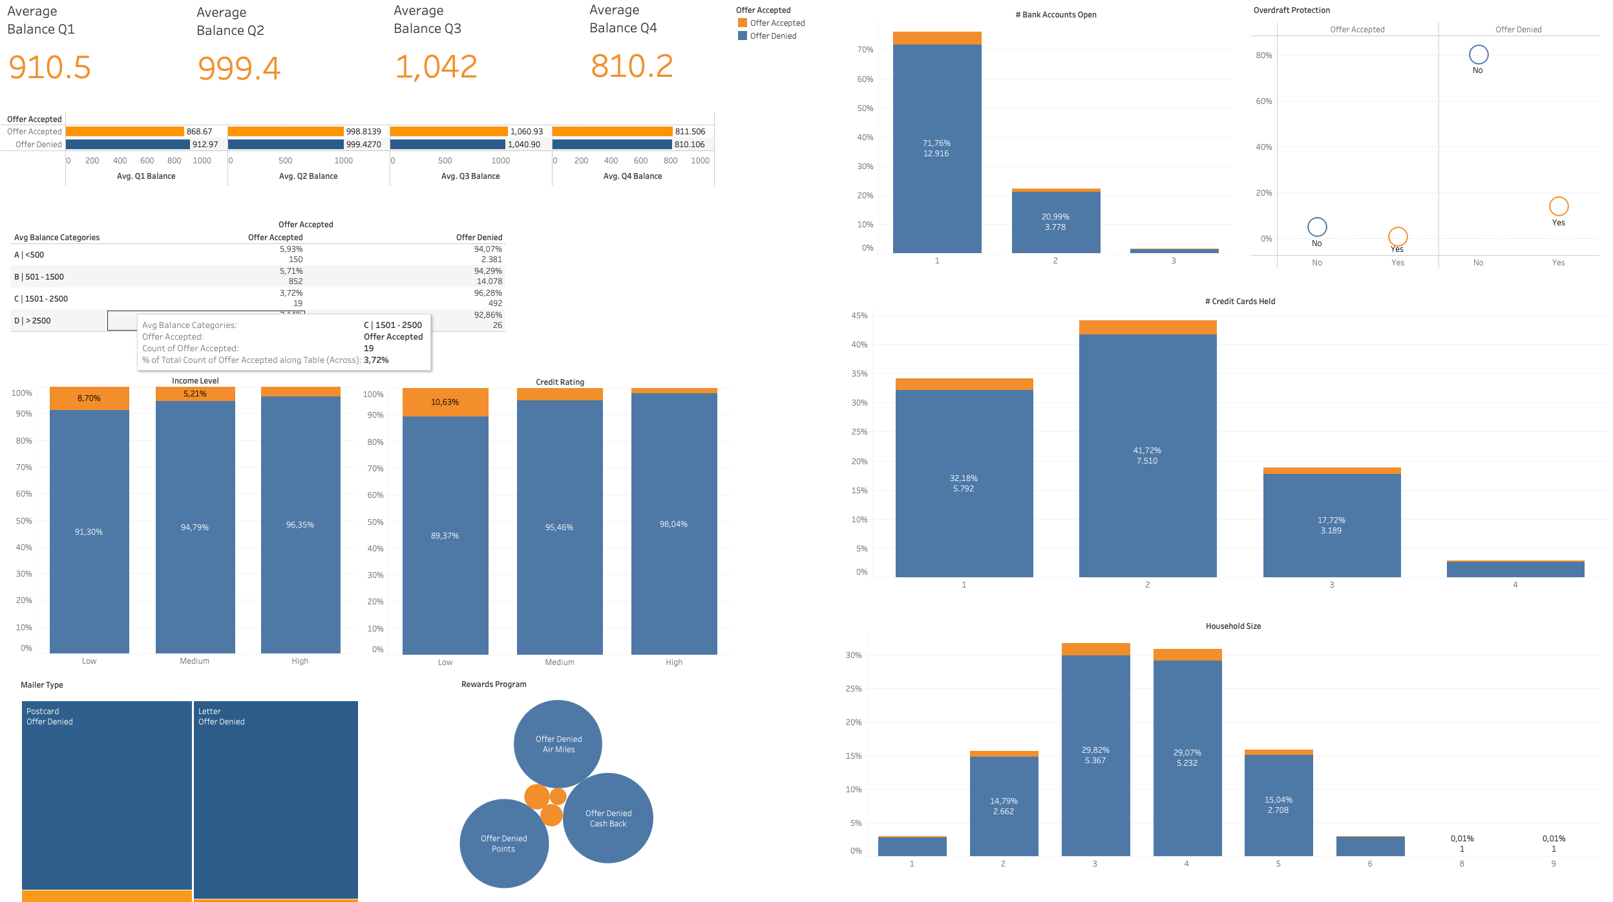
Exploratory Data Analysis

Slide 6
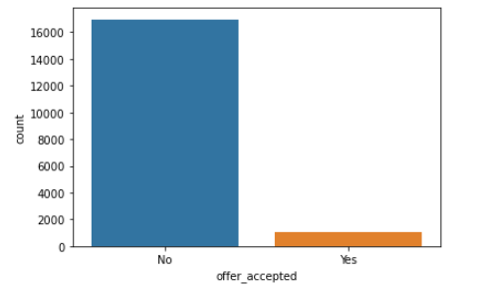
Exploratory Data Analysis
High data imbalance

Slide 7
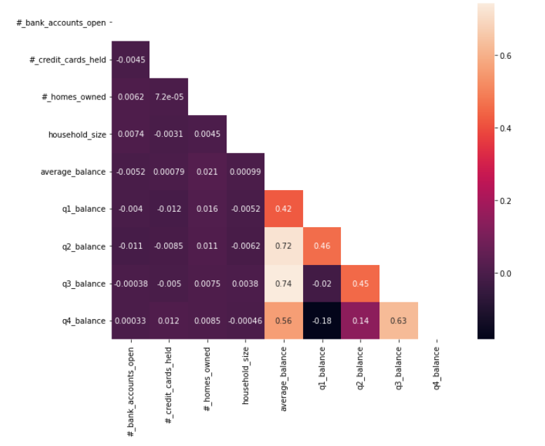
Exploratory Data Analysis
No high multicollinearity

Slide 8
Benchmark
Precision is the percentage of clients that accepted the offer and were correctly identified.
Precision (P) = TP/(TP+FP)
Recall is the percentage of the relevant clients (who accepted an offer) that could be successfully identified.
Recall(R) (Sensitivity) = TP/(TP+FN)
When we want accurately identify people who rejected an offer, then the
number of true negatives should be high, which would require a high specificity.
Specificity = TN/(TN+FP)

Slide 9
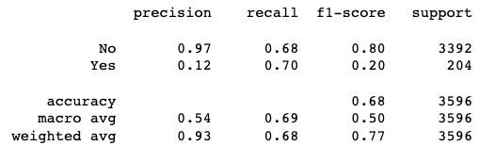
Benchmark
Because our objective is to identify those who will accept an offer, we want to get most positives as possible, which translate into high recall.
Precision
Specificity
Recall (Sensitivity)

Slide 10
Optimization
To optimize our model, we applied different methods and compared how much they would improve or not the recall of the model
Encoders (OneHot Encoder)
Scalers (StandardScaler, Normalizer, BoxCox)
Outliers (Drop for Average, Q2, Q3 and Q4 balances)
Balancers (SMOTE, Over and Undersampling, TomekLinks)

Slide 11
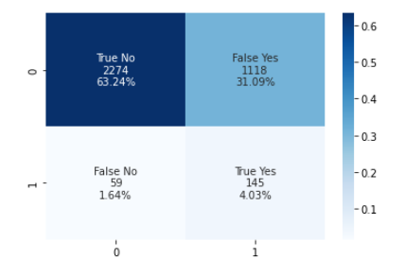
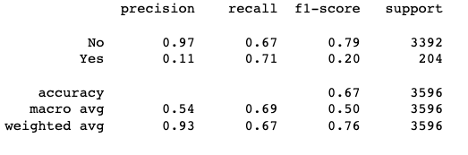
Optimization
Final Model
Our final model managed to optimize both specificity and recall, so we could correctly identify customers that will accept the offer and also those who will reject it

Slide 12
Models Comparison
Models
Recall Score
LogisticRegression
MultinomialNB
GaussianNB
DecisionTreeClassifier
KNeighborsClassifier
SVC
0,71
0,60
0,58
0,15
0,14
0,06

Slide 13
Business Case
Assuming that the bank provides us with the following information:
1M active clients in the last fiscal year;
$5 is the cost to print a new card and send it via mail to a client;
$150 is the average profit for an accepted offer by the client.
Then:
Every true positive: $150 - $5 = +$145 (card sent, offer accepted)
Every true negative: $0 (card not sent)
Every false negative: - $150 (card not sent, lost opportunity for an offer acceptance)
Every false positive: - $5 (card sent, offer not accepted)

Slide 14
Business Case
With the active customers from last fiscal year, according to our model:
If the bank sent a card to every client, it would have - $1,2M in revenue
Sending a card to clients identified as potential accepters would generate $1,8M
Savings: $ 3M

Slide 15

Thank You!!

